Slide 1


How to really use ChatGPT Plus GPT’s

Slide 2


Slide 3

"I definitely fall into the camp of thinking of AI as augmenting human capability and capacity."
- Satya Nadella, CEO Microsoft

Slide 4
Why ChatGPT Plus?
Supreme Knowledge for $20 / Month

Slide 5
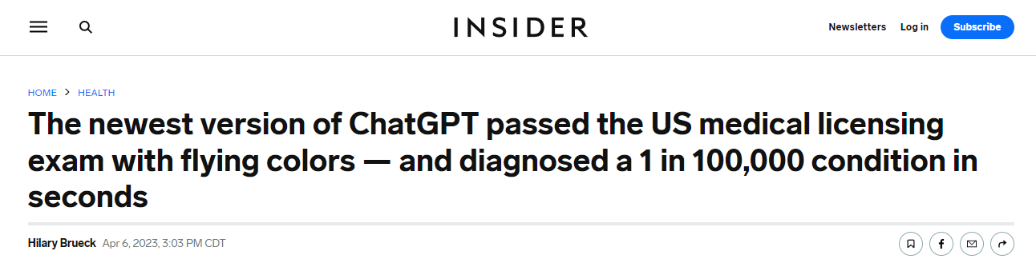
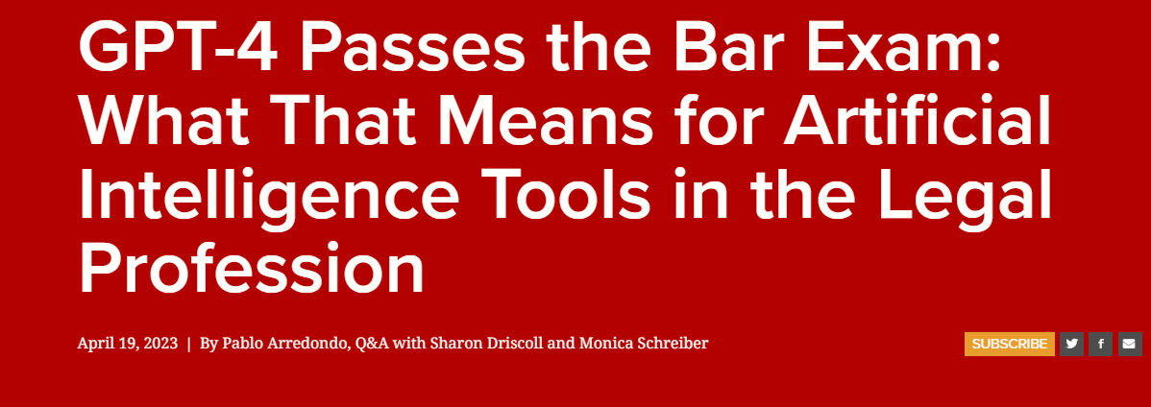
Notes:
https://www.insider.com/chatgpt-passes-medical-exam-diagnoses-rare-condition-2023-4
https://law.stanford.edu/2023/04/19/gpt-4-passes-the-bar-exam-what-that-means-for-artificial-intelligence-tools-in-the-legal-industry/

Slide 6
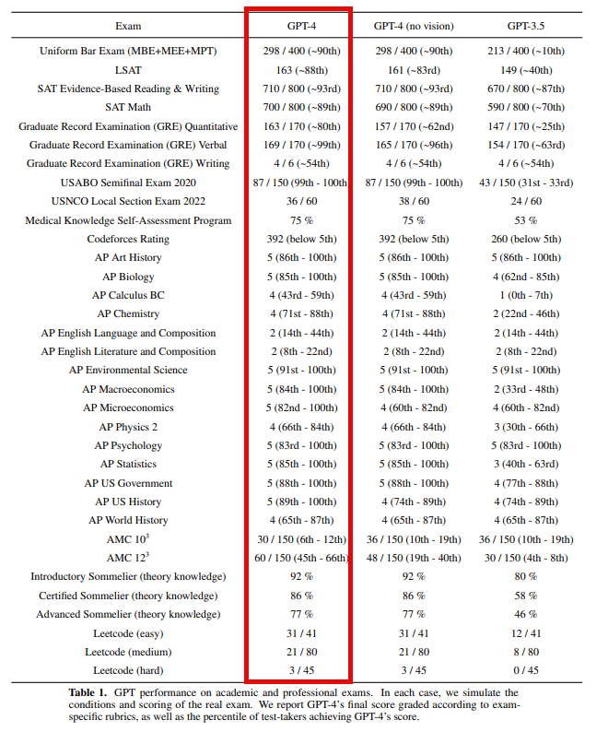
Notes:
https://cdn.openai.com/papers/gpt-4.pdf

Slide 7
Use the website, Get the mobile App
Website - https://chat.openai.com/
Mobile
Android - https://play.google.com/store/apps/details?id=com.openai.chatgpt&hl=en_US&gl=US&pli=1
iPhone - https://apps.apple.com/us/app/chatgpt/id6448311069

Slide 8
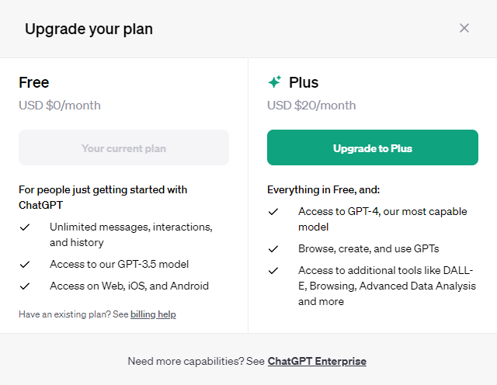
Upgrading

Slide 9
GPT’s
Focus is key

Slide 10
ChatGPT
Specialized Instructions
GPT

Slide 11
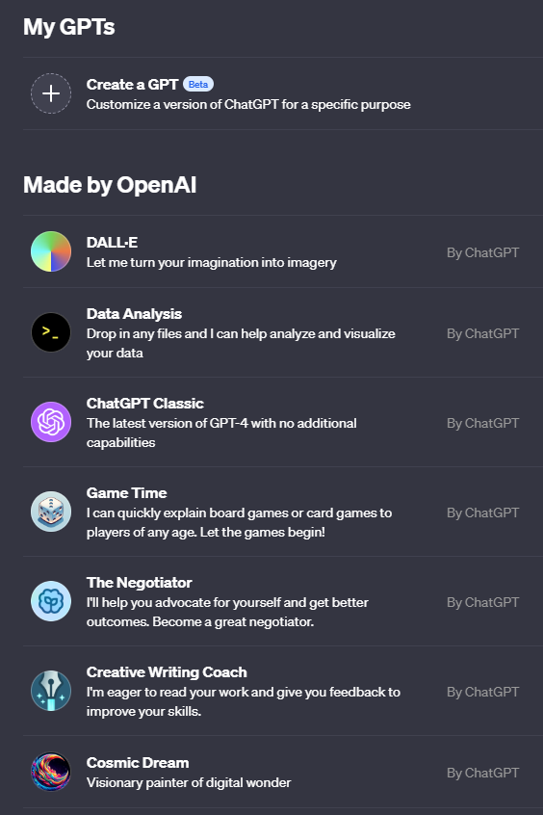

How to Get Them

Slide 12
Using gpt’s

Slide 13
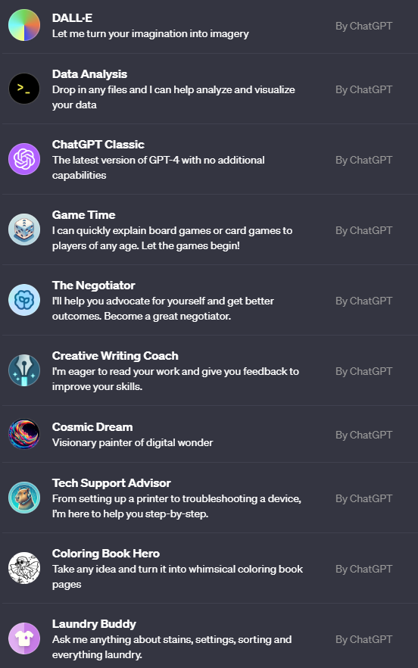

Slide 14


